Slide 1



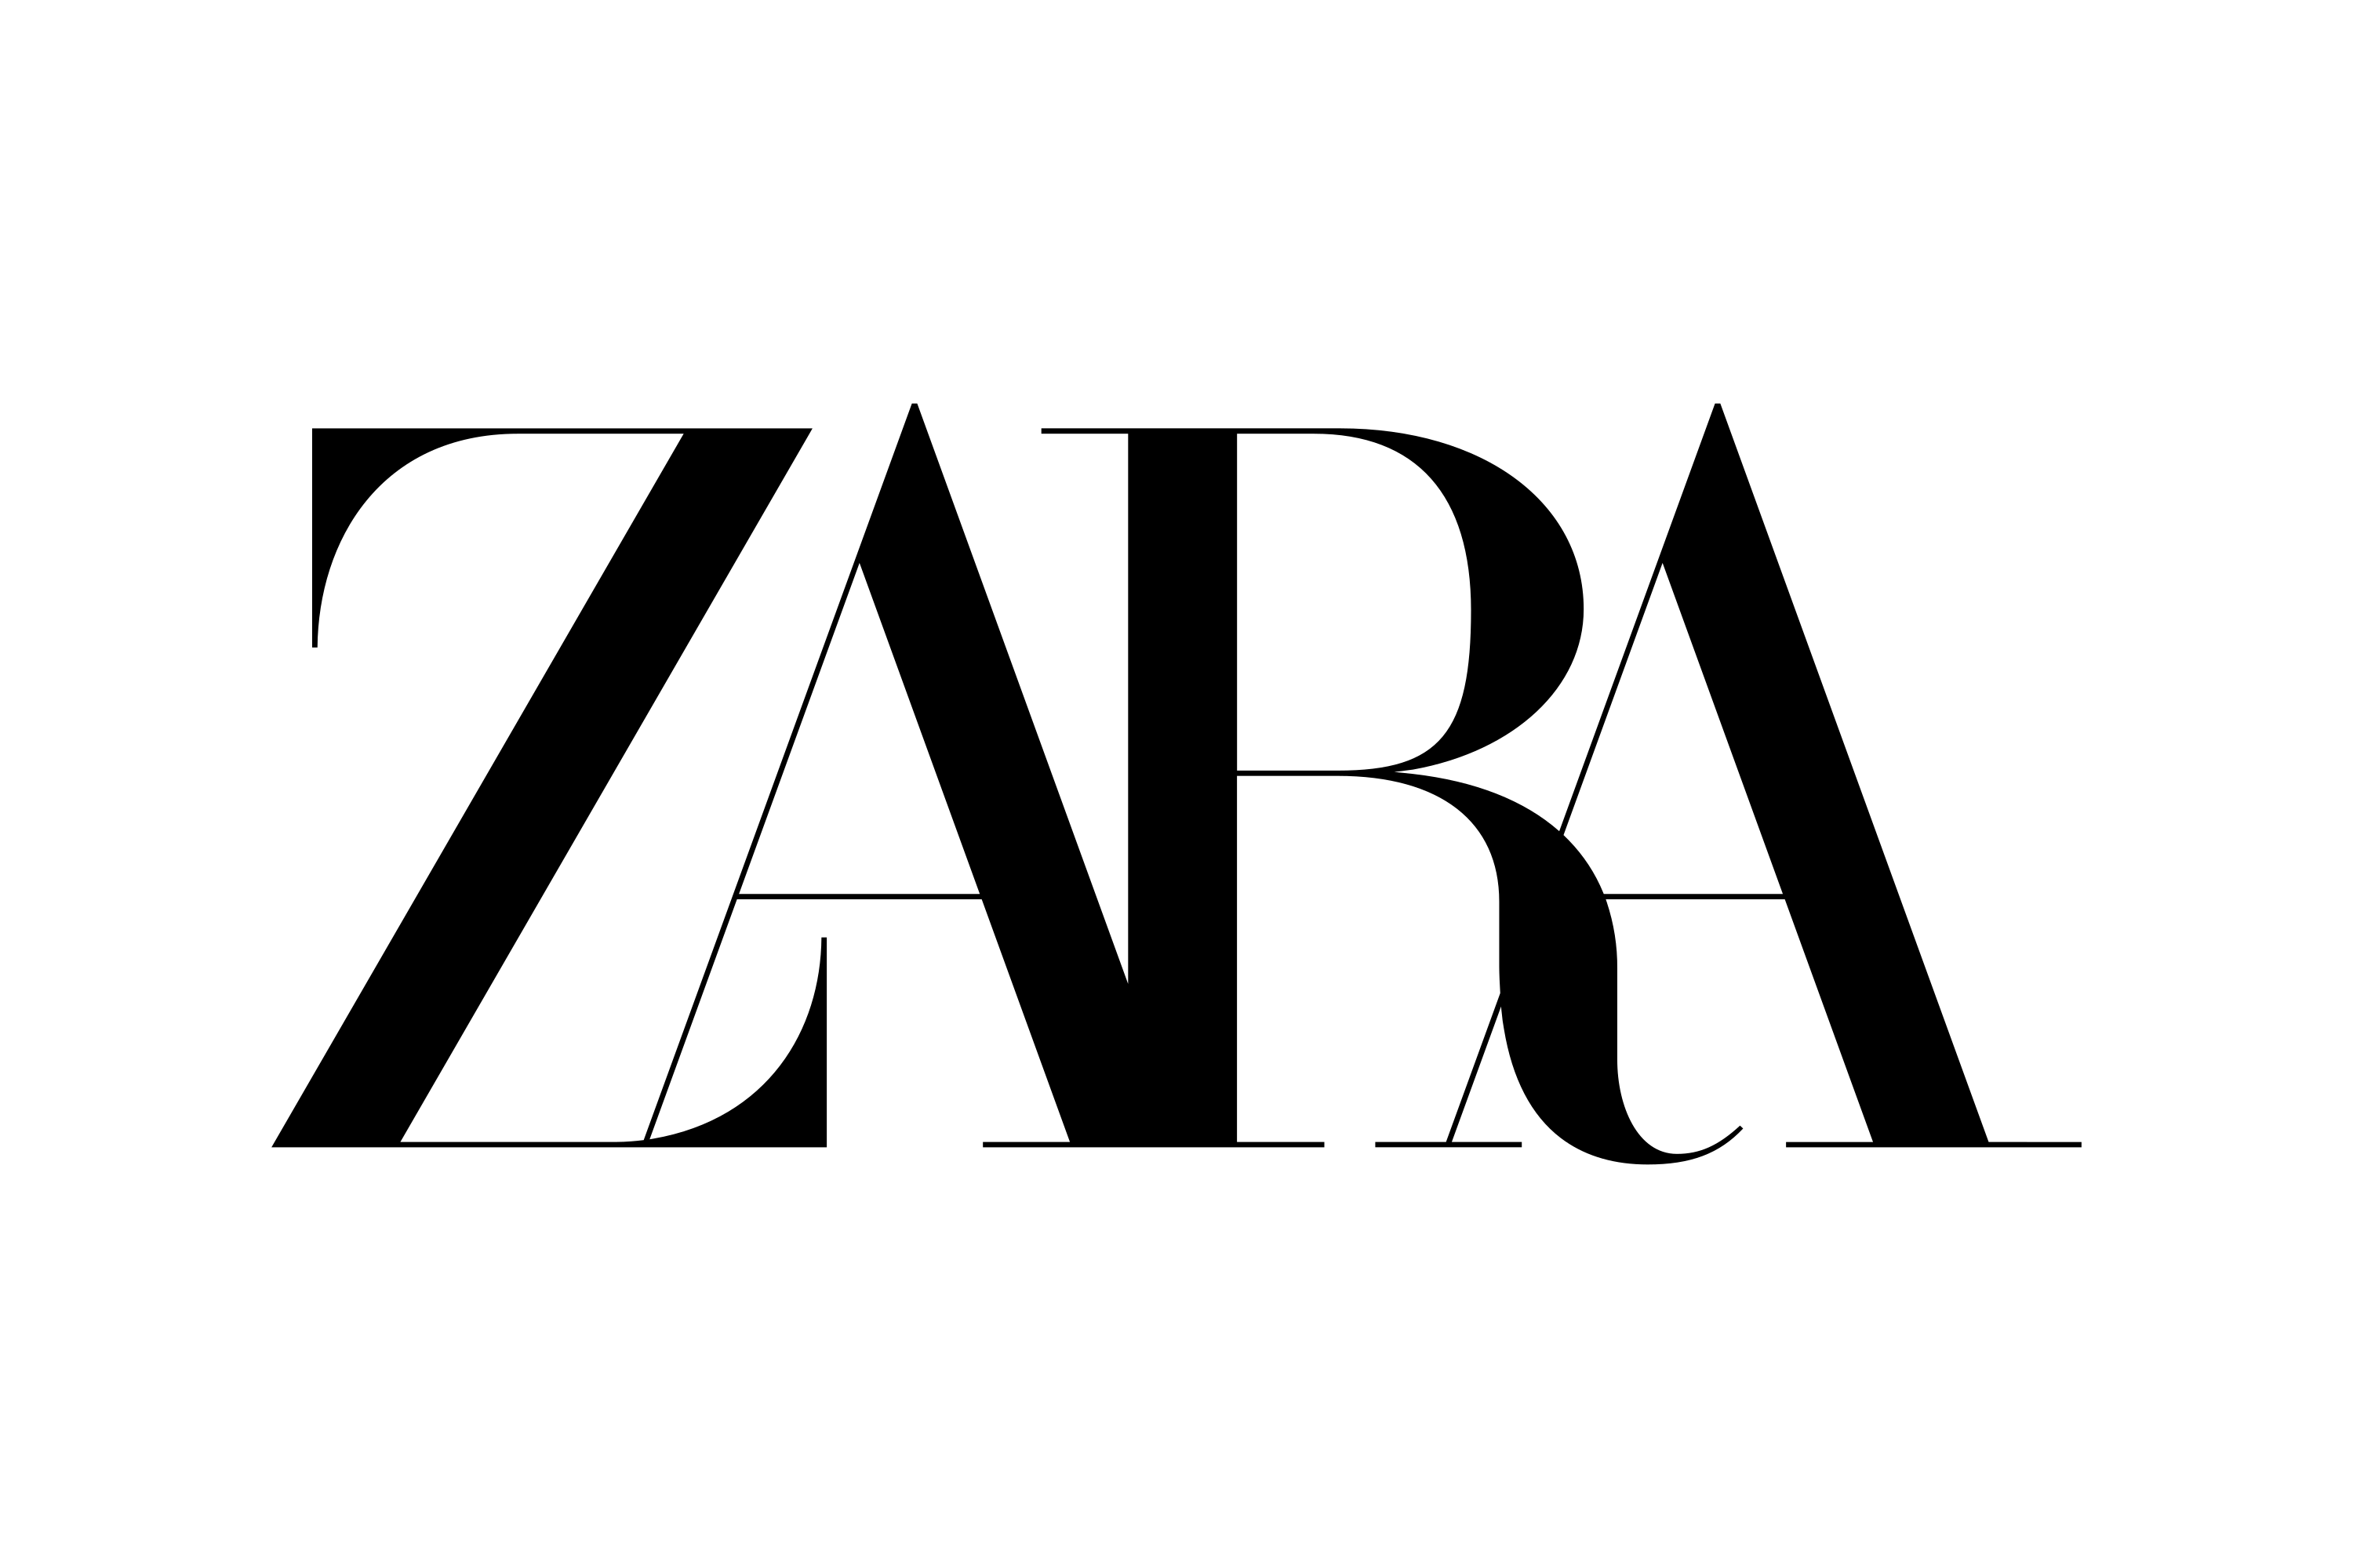
Fast fashion brands DATA analysis.
Leveraging SQL AND POWER BI FOR DEEPER UNDERSTANDING.

Slide 2

objective -
To analyze customers demographics, order patterns, and brand sales performance over the years.
Key Metrics: Total customers, sales, total orders, customer segmentation by gender,customers by age and region, sales by product categories and cities, etc.

Slide 3
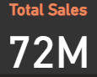
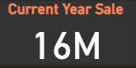
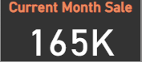
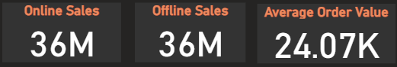
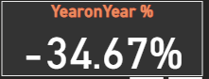
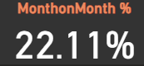
Title: Sales Analysis Overview-
KPI’S:
Tool used-Power BI
Total Sales: 72M
Current year sale: 16M
Current Month Sales: 165k
Online vs. Offline: Offline (36M), Online (36M)
Average Order Value: 22.39K
Year on year percentage change in sales
Month on month percentage change in sales

Slide 4
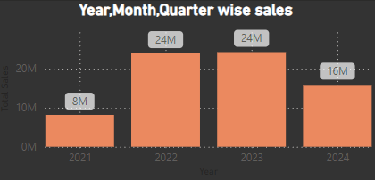
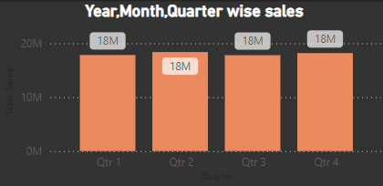
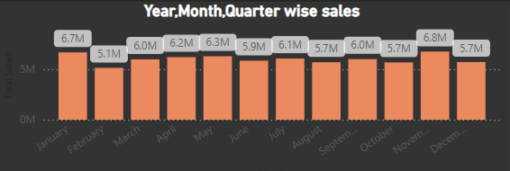
Title: yearly quarterly and month wise sales analysis
1-Sales by Year: 2021 sales decline due to Covid19.
2022-2023 increase, 2024 decline.
2-Mostly all quarters doing equal Sales,No seaosonal effects occour.
3-November and january month has highest sales due to winters maybe

Slide 5
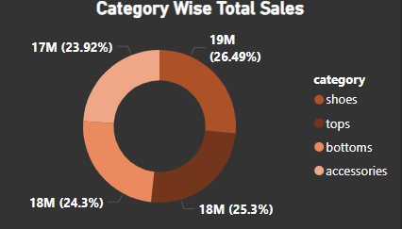
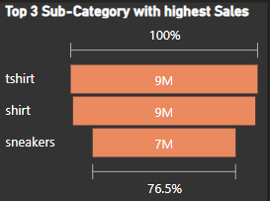
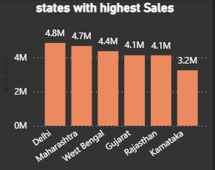
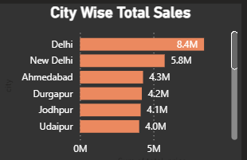
Title: Category and Regional Performance
Top Categories:
1-shoes
2-tops
3- bottoms
4-accessories
Top Sub-Categories:
1-TShirt
2-Shirt
3-Sneakers
Top States:
1-delhi,
2-maharashtra,
3-westbengal
4.Gujrat
Top cities:
1.Delhi,
2.Ahmedabad,
3.Durgapur

Slide 6
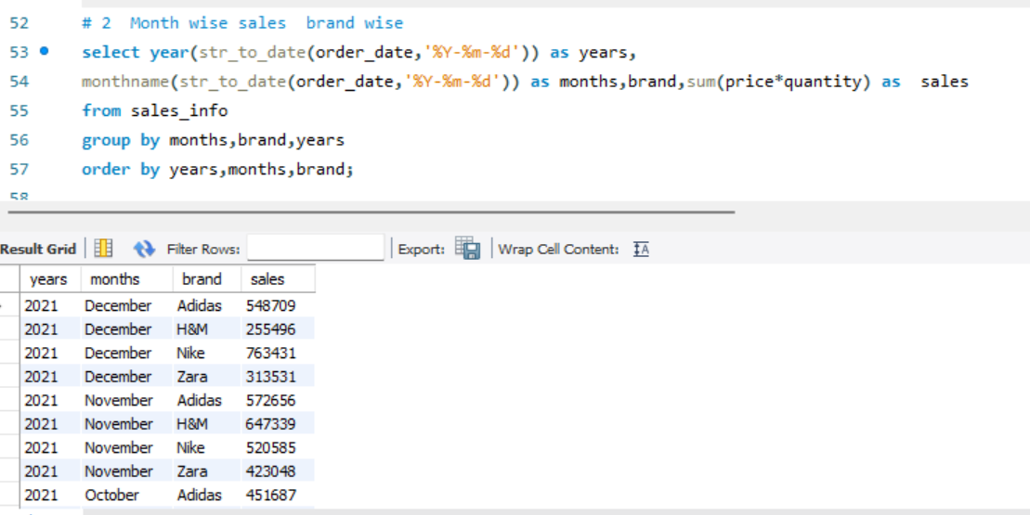
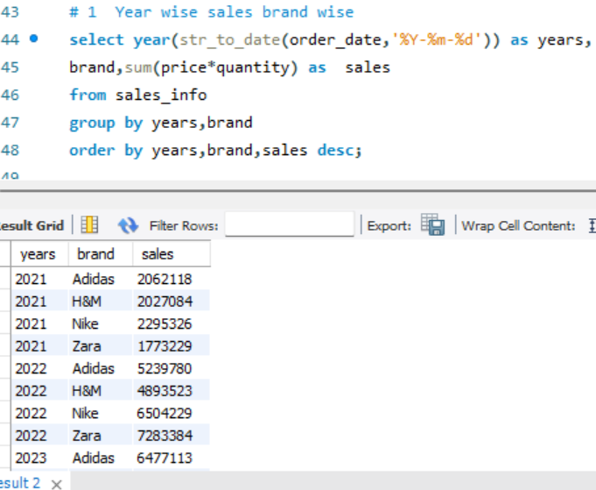
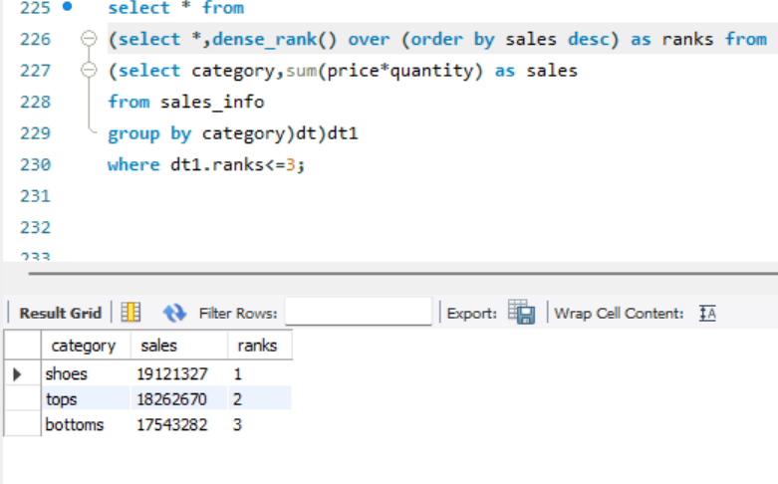
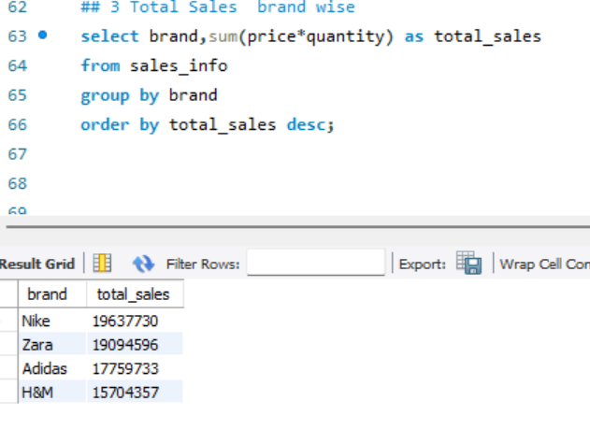
and monthly order trends (Line Chart)
using sql sales analysis
Month wise sales brand wise
Year wise sales brand wise
Top categories
Top sales by brand

Slide 7
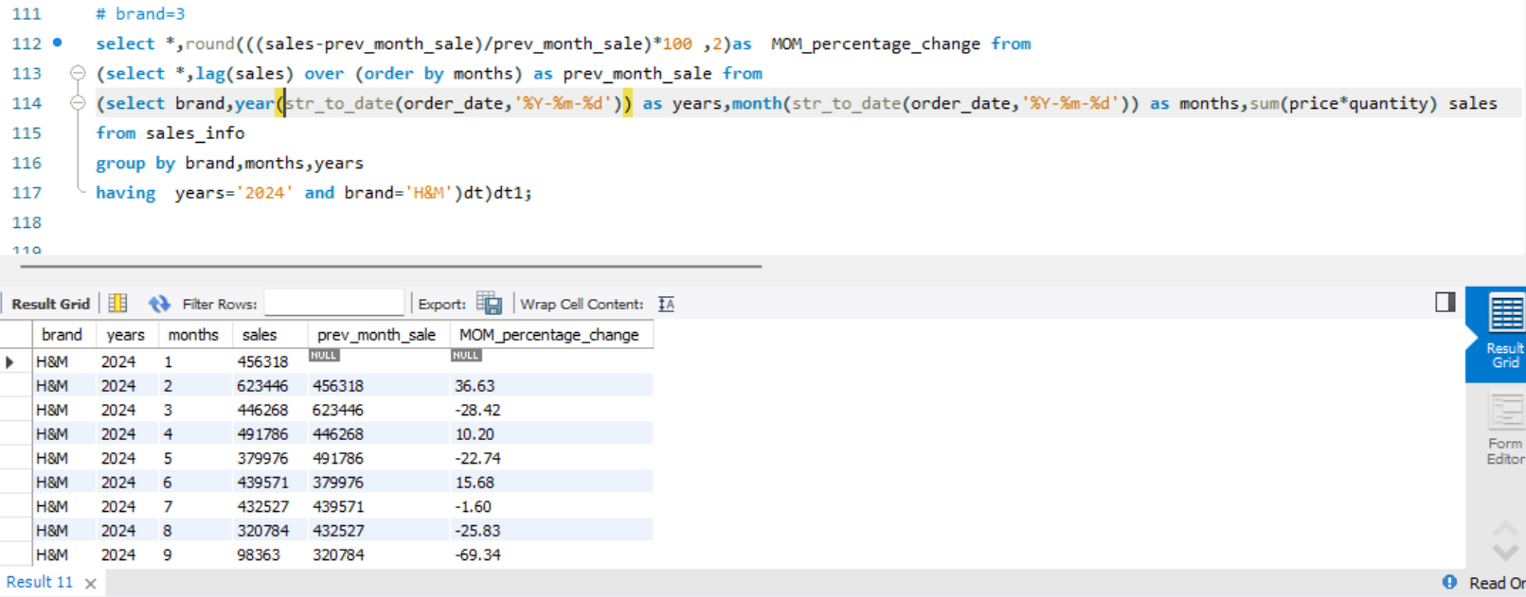
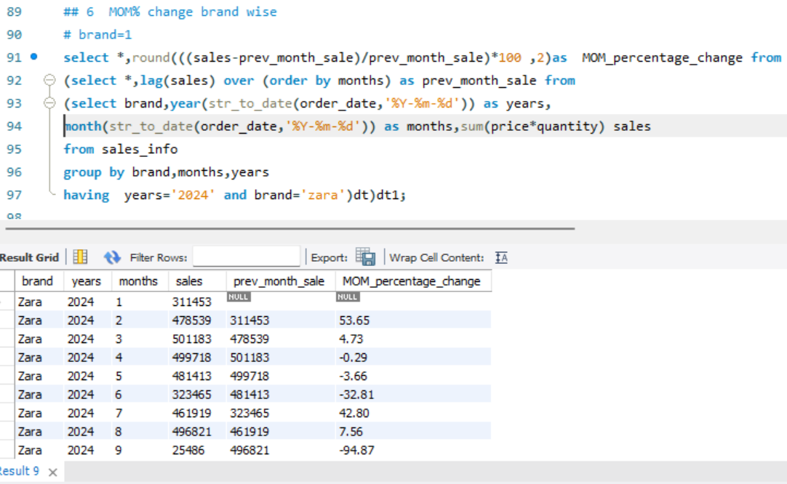
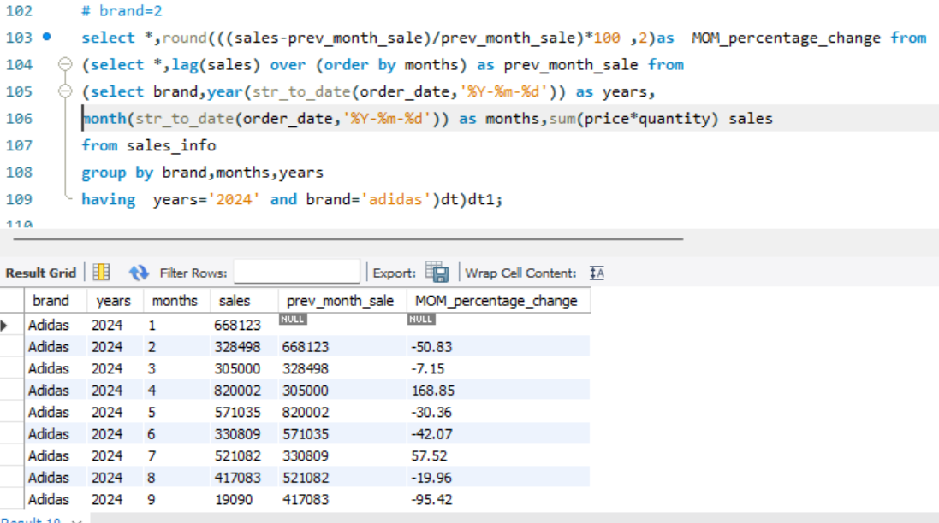
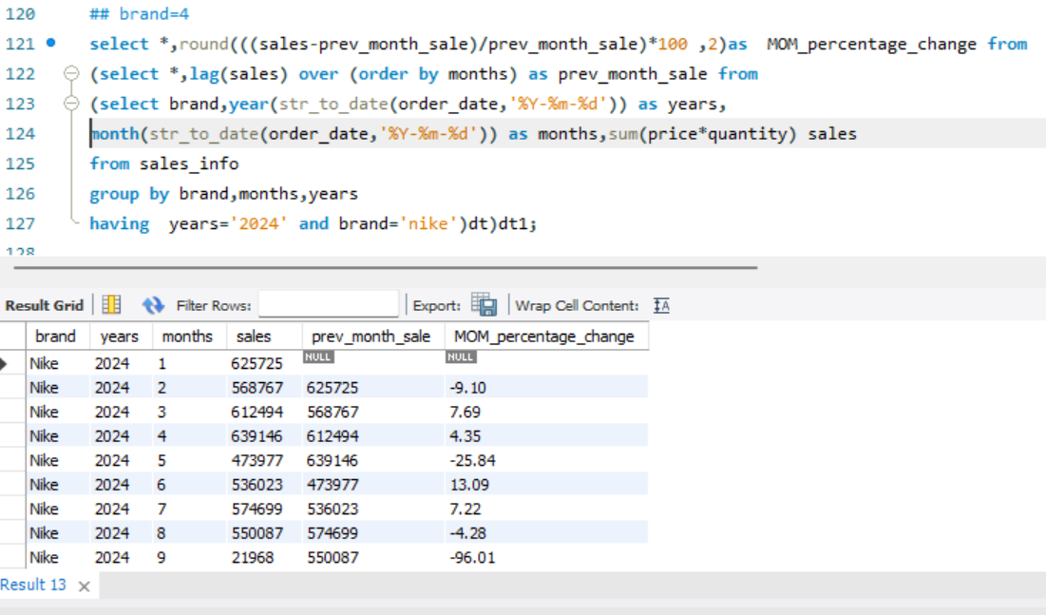
MONTH ON MONTH PERCENTAGE CHANGE IN SALES with ALL THE BRANDS:
MONTH ON MONTH PERCENTAGE CHANGE BRAND-H&M
MONTH ON MONTH PERCENTAGE CHANGE
BRAND- ZARA
MONTH ON MONTH PERCENTAGE CHANGE BRAND- ADIDAS
MONTH ON MONTH PERCENTAGE CHANGE BRAND- NIKE

Slide 8
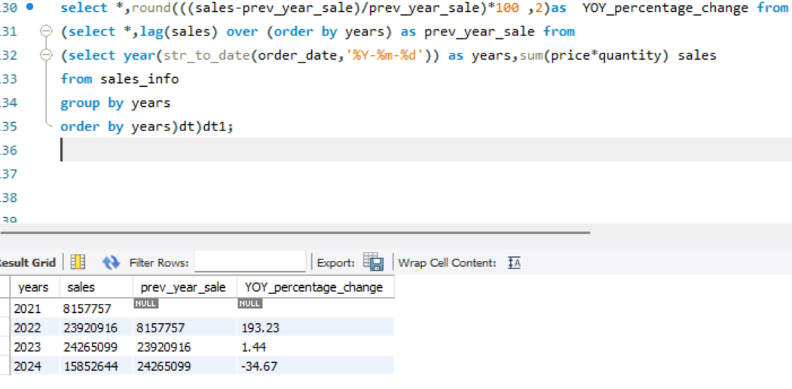
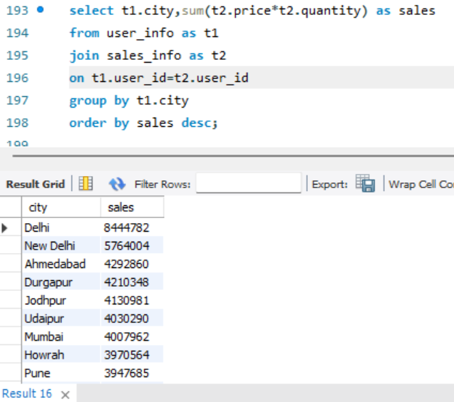
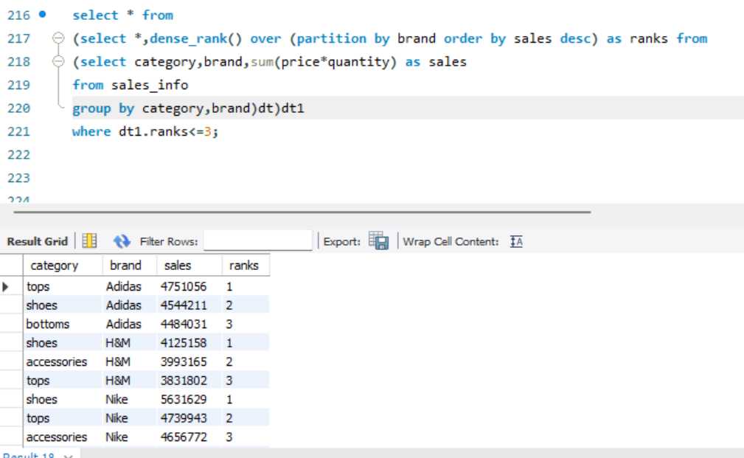
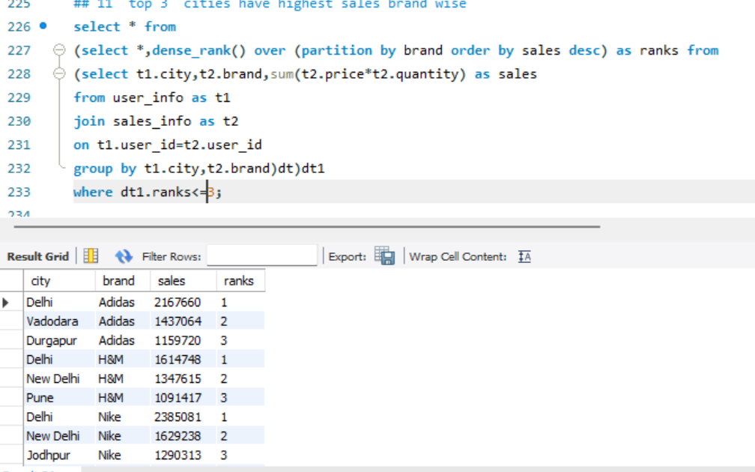
TOP CITIES SALES WISE
YEAR ON YEAR PERCENTAGE IN SALES
TOP 3 CITIES WITH HIGHEST SALES BRAND WISE
CATEGORY WISE HIGHEST SALES BRAND WISE

Slide 9
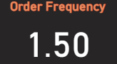
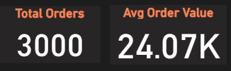
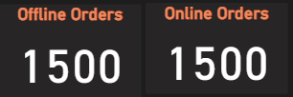
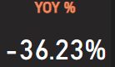
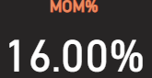
ORDERS ANALYSIS
Key Metrics:
Tool used-Power BI
Total Orders: 3,000
Adidas-741 orders
Nike-692 orders
H&M-784
Zara-783 orders
Avg Order Value: ₹24.07k
Order Frequency: 1.5%
Offline and Online orders are equal
Year on year percentage in orders
Month on month percentage change in orders

Slide 10
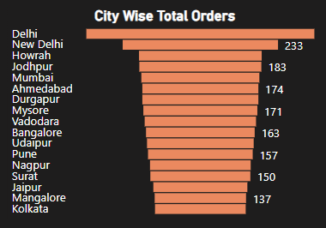
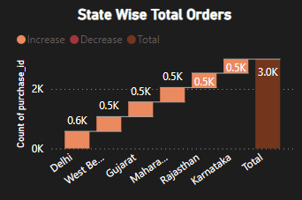
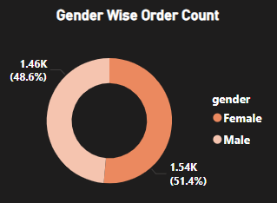
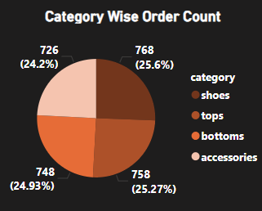
City-Wise and Category-Wise and gender wise Orders
Key Metrics:
Top Cities: Delhi (233), New Delhi (137), Mumbai (183)
Top states-
Delhi Had highest orders(0.6k)
West Bengal(0.5k)
Gujrat(0.5k)
Order Categories:
Shoes (25.6%), Tops (24.93%), Bottoms
(25.27%), Accessories (24.24%)
Gender wise orders:
Female has highest order rate (51.4%)
Male Has order rate(48.6%)

Slide 11
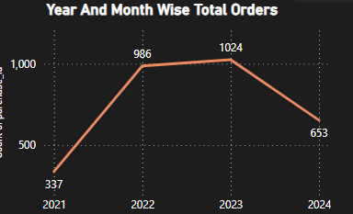
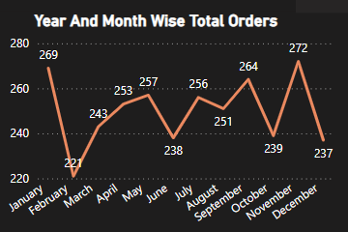
Year and month wise orders analysis:
>January and November had highest orders may be due to winters season.
>2021 had lowest orders may be due to covid-19
>2022 had 986 orders good as compare to
2021
>2023 had highest orders(1024)
>2024 is ongoing year

Slide 12
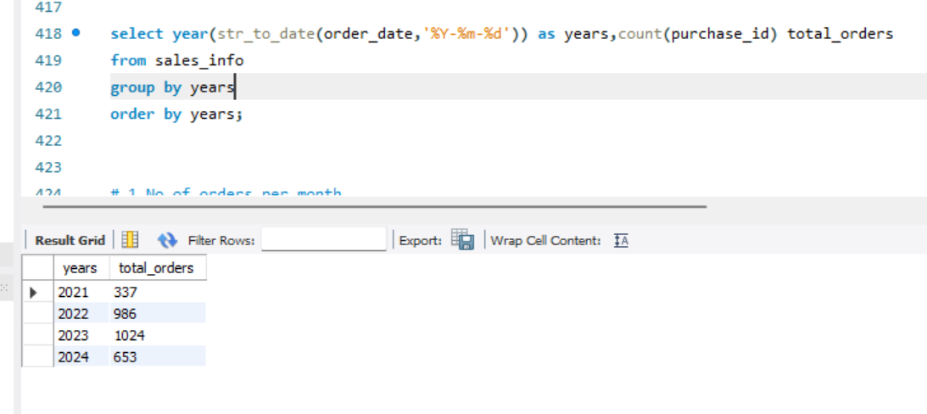
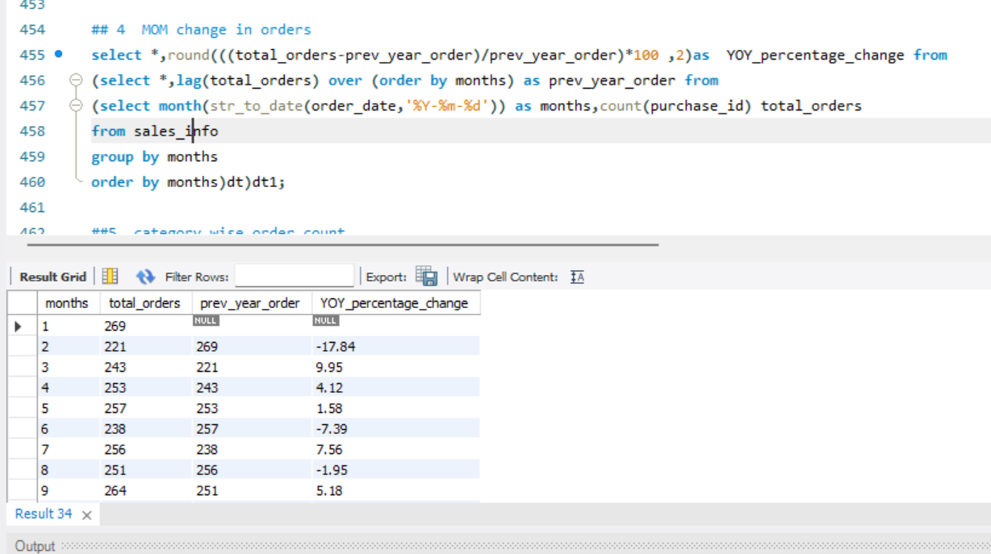
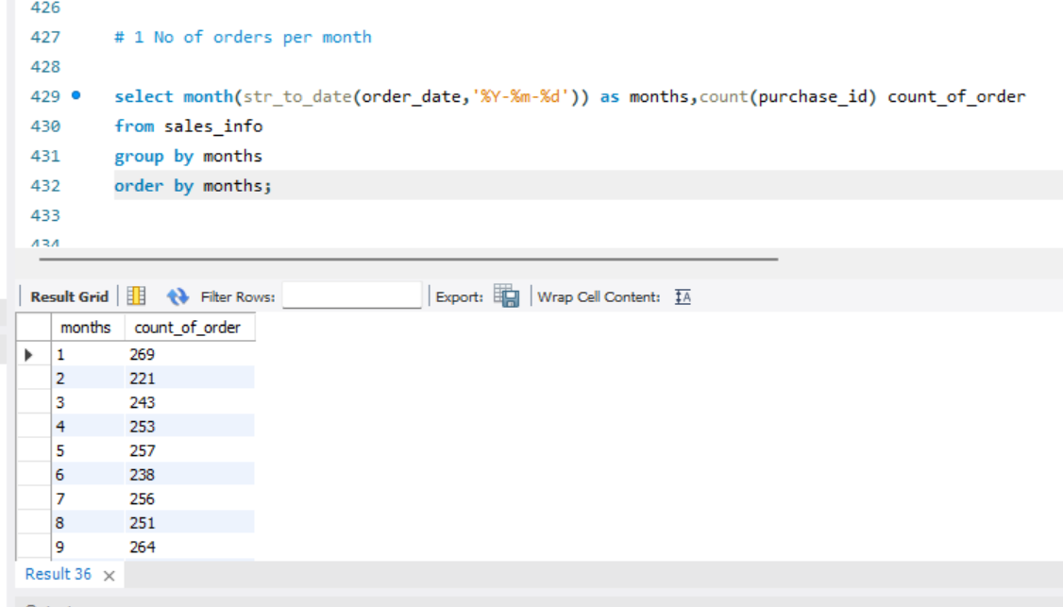
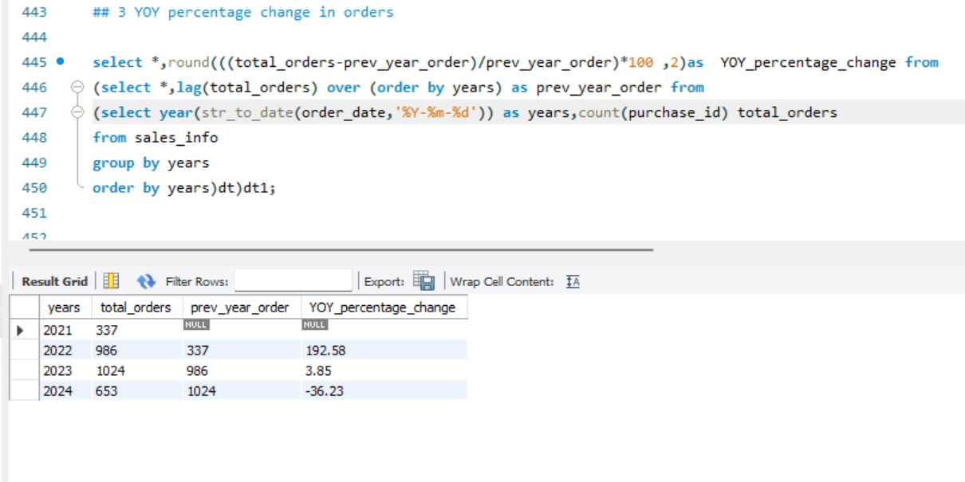
Orders Analysis using SQL
MOM% change in orders
No of orders per year
No of orders per month
Year on Year% change in orders

Slide 13
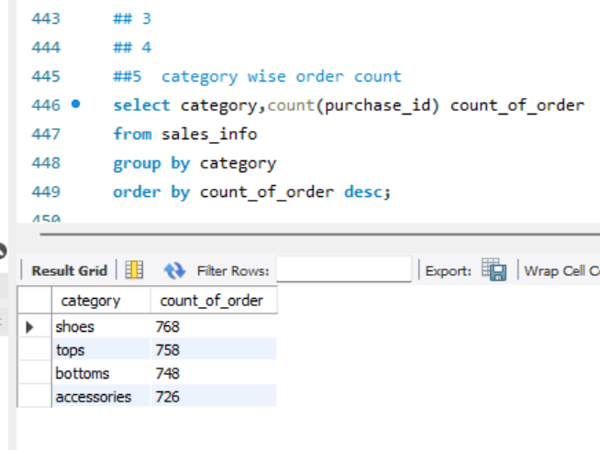
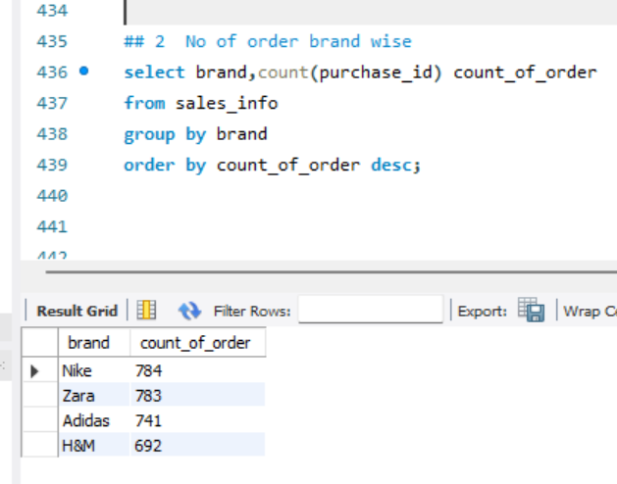
Category wise total count
No of orders by brands

Slide 14
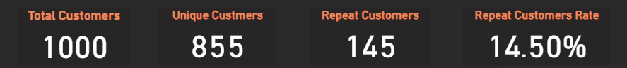
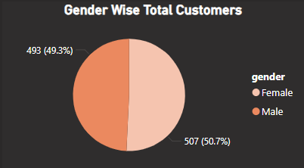
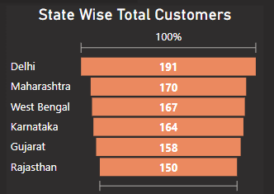
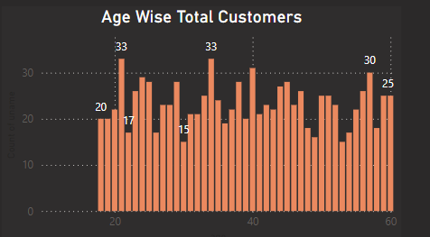
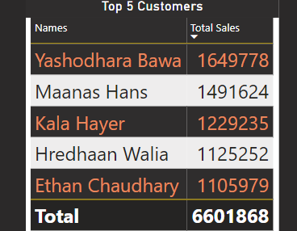
Customers Analysis
Key Metrics:
Total Customers: 1,000
Unique Customers: 855
Repeat Customers: 145
Repeat Customer Rate: 14.5%
Gender Distribution (Pie Chart): 50.7% Male, Female, 49.3
Top 3 states have Highest Customers:
1>Delhi
2>Maharashtra
3>West Bengal
Age wise customers:
20-40 age range groups have highest customers

Slide 15
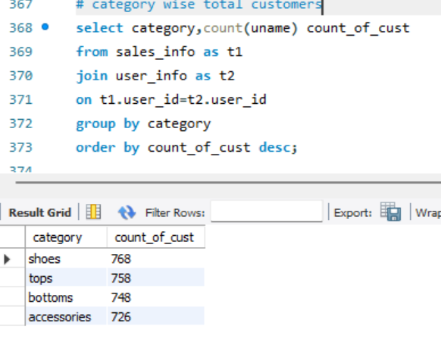
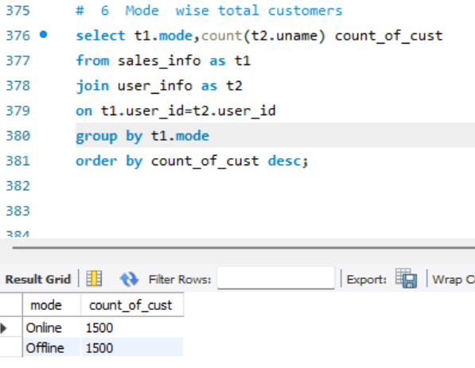



Customer Analysis using SQL::
Transaction wise total customers
Category wise total Customers
Top 5 customers with highest sales
Customer with repeat orders brands wise
Brand wise total customers

Slide 16
INFERENCE
Top Product Categories: Casual shoes and tops are the top sellers, indicating that these are the most popular product categories. Brands should introduce more variations in these categories or increase inventory to capitalize on demand.
State-Wise Sales: High sales in New-Delhi, West Bengal and Maharashtra suggest these regions are key markets. Focused regional marketing strategies and deeper penetration into these markets could yield better results
Offline vs. Online Sales: Online and Offline are equal
Sales Decline in 2021: The decrease in sales in 2021 suggests that external factors or internal challenges (such as stock availability or customer satisfaction) may have impacted performance or may be Covid impact the sales of 2021. Investigating this further will help in devising corrective strategies.

Slide 17
Category-Wise Orders: The almost equal distribution of sales across categories (shoes, tops, bottoms, accessories) shows that customers are not overly reliant on a single product category, which provides the brand with diversified revenue streams.
City-Wise Orders: Delhi and Mumbai are leading in terms of orders, which may indicate a stronger presence or higher customer base in these cities. Expanding in high-potential areas and cities with lower engagement could boost sales further.
Yearly Orders Breakdown: The increase in orders between 2021 and 2023 signifies strong growth. However, the drop in 2024 may require investigating the causes (economic conditions, competition, or product availability) and addressing them
Top Customers: The presence of repeat top customers suggests a loyal customer base. More incentives (loyalty programs or personalized offers or discounts ) can encourage repeat purchases
Gender Distribution: The gender distribution is almost equal, indicating that both male and female customers are equally important to the fast fashion business.
Age Distribution: Mostly Customers are from age group 20-40 age group so different product lines or promotional strategies can be targeted to different age groups. If younger customers dominate, brands may want to focus on trendy, budget-friendly options

Slide 18
Thank You!
Thank you for your time and attention. We hope this analysis provides valuable insights into fast fashion sales, customer preferences, and order trends.
Feel free to ask any questions or share your feedback.
Stay Fashionable, Stay Ahead!

